Slide 1

Management of FHB and DON in Wheat:
A 2022 Update
Drs. Pierce A. Paul and Wanderson Bucker Moraes
The Ohio State University

Slide 2
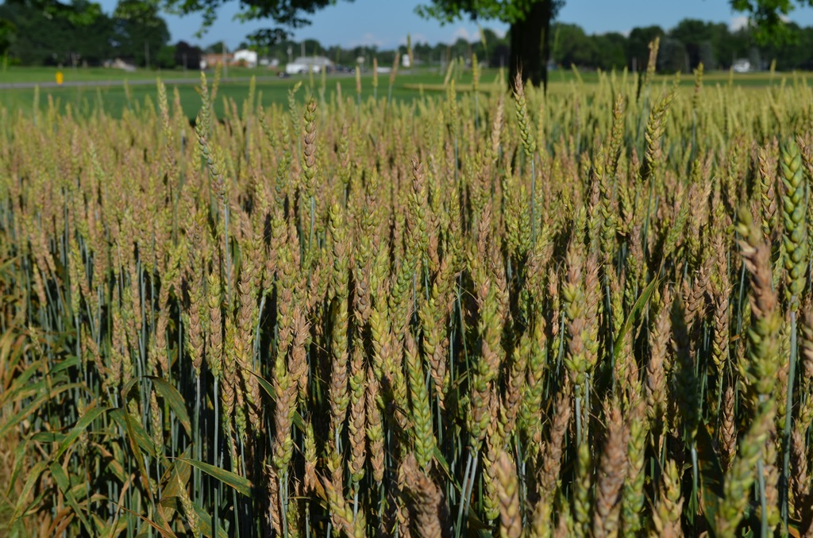
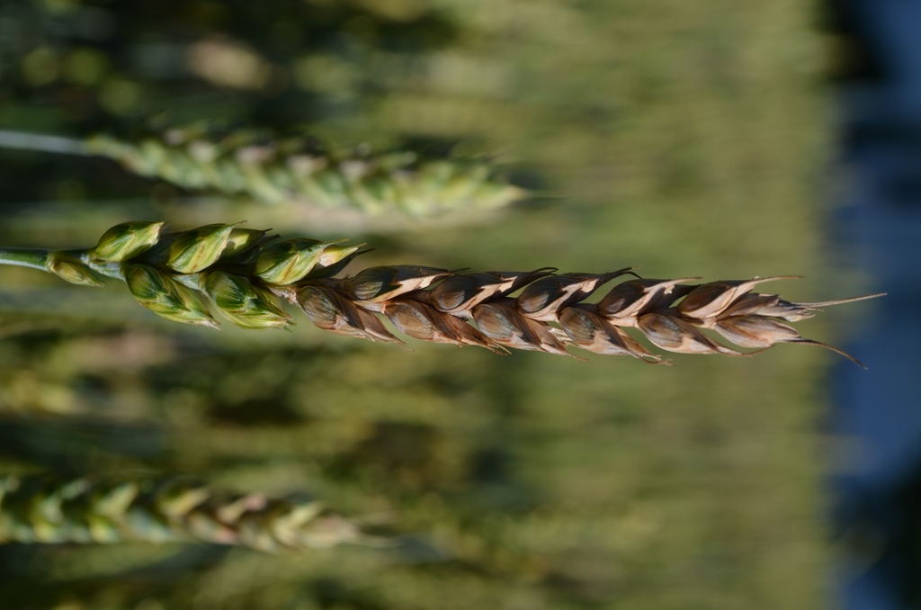
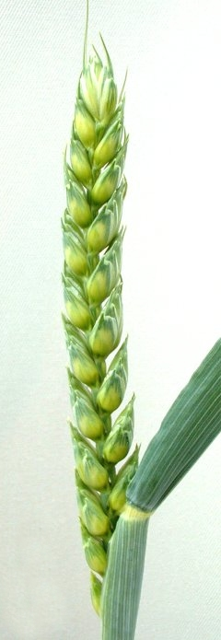
Fusarium head blight (head scab)
Fusarium graminearum (Gibberella zeae)
Grain yield and quality losses
Grain contamination with mycotoxins
Food safety concerns – humans and animals
Reduce flour yield and milling and baking quality

Slide 3
Miravis Ave
SDHI - Pydiflumetofen
+
DMI - Propiconazole

Slide 4
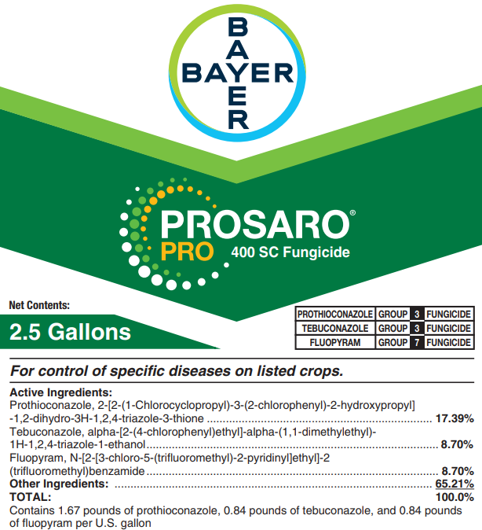
Prosaro Pro
DMI – Prothioconazole
+
DMI – Tebuconazole
+
SDHI – Fluopyram

Slide 5
Sphaerex
DMI – Metconazole
+
DMI – Prothioconazole

Slide 6
Fungicide-Only Programs:
New Products vs Industry Standards

Slide 7
Fungicide Programs
Treatment program | Treatment Program | Rate (fl oz/A) | Timing
Code | Product
CK | Nontreated | --- | ---
I | Prosaro | 6.5 | Feekes 10.5.1
II | Caramba | 13.5 | Feekes 10.5.1
III | Miravis Ace | 13.7 | Feekes 10.5.1
IV | Prosaro Pro | 10.3 | Feekes 10.5.1
V | Sphaerex | 7.3 | Feekes 10.5.1
VI | Miravis Ace fb Prosaro Pro | 13.7/10.3 | Feekes 10.5.1/4-6 DAA
VII | Miravis Ace fb Sphaerex | 13.7/7.3 | Feekes 10.5.1/4-6 DAA
VIII | Miravis Ace fb Tebuconazole | 13.7/4 | Feekes 10.5.1/4-6 DAA
DAA = days after anthesis (Feekes 10.5.1)
All treatments applied with a non-ionic surfactant @ 0.125% V/V

Slide 8
Head Scab (FHB)
68 to 95%
Reduction in Scab
Fungicide treatment programs: non-treated check (CK), or an application of Prosaro (I), Caramba (II), Miravis Ace (III), Prosaro Pro (IV), or Sphaerex (V) at anthesis, or Miravis Ace at anthesis followed by an application of Prosaro Pro (VI), Sphaerex (VII), or Tebuconazole (VIII) at 4-6 days after anthesis.
Notes:
Two-treatment programs resulted in the lowest levels of Scab

Slide 9
Vomitoxin (DON)
54 to 85%
Reduction in DON
Fungicide treatment programs: non-treated check (CK), or an application of Prosaro (I), Caramba (II), Miravis Ace (III), Prosaro Pro (IV), or Sphaerex (V) at anthesis, or Miravis Ace at anthesis followed by an application of Prosaro Pro (VI), Sphaerex (VII), or Tebuconazole (VIII) at 4-6 days after anthesis.
Notes:
Two-treatment programs resulted in the lowest levels of DON

Slide 10
Efficacy Compared to Prosaro - FHB
Percent (%)
Fungicide programs: Caramba (II), Miravis Ace (III), Prosaro Pro (IV), or Sphaerex (V) at anthesis, or Miravis Ace at anthesis followed by an application of Prosaro Pro (VI), Sphaerex (VII), or Tebuconazole (VIII) at 4-6 days after anthesis.
Notes:
Performance of New products and two-treatments programs compared to Prosaro at anthesis:
Bars above the 0-reference line show programs that are x% better than Prosaro at reducing head scab (FHB)

Slide 11
Efficacy Compared to Prosaro - DON
Percent (%)
Fungicide programs: Caramba (II), Miravis Ace (III), Prosaro Pro (IV), or Sphaerex (V) at anthesis, or Miravis Ace at anthesis followed by an application of Prosaro Pro (VI), Sphaerex (VII), or Tebuconazole (VIII) at 4-6 days after anthesis.
Notes:
Performance of New products and two-treatments programs compared to Prosaro at anthesis:
Bars above the 0-reference line show programs that are x% better than Prosaro at reducing vomitoxin (DON)

Slide 12
Integrated Management:
Fungicide + Variety Resistance

Slide 13
Fungicide x Resistance - Scab
93 to 95% Reduction
84 to 88% Reduction
56 to 83% Reduction
MR = Moderately Resistant, MS = Moderately Susceptible, S = Susceptible
CK: non-treated; I – Prosaro, II - Miravis Ace, III - Prosaro Pro, IV - Sphaerex
Notes:
Integrated management programs: - percent reduction estimated relative to S_CK (the susceptible untreated check)
All fungicides performed equally well at reducing scab on MR and MS varieties
Lowest levels of disease when fungicide treatments were combined with moderate resistance

Slide 14
Fungicide x Resistance - DON
87 to 93% Reduction
77 to 87% Reduction
63 to 74% Reduction
MR = Moderately Resistant, MS = Moderately Susceptible, S = Susceptible
CK: non-treated; I – Prosaro, II - Miravis Ace, III - Prosaro Pro, IV - Sphaerex
Notes:
Integrated management programs: percent reduction estimated relative to S_CK (the susceptible untreated check)
All fungicides performed similarly at reducing DON within a given variety resistance class
Lowest levels of disease when fungicide treatments were combined with moderate resistance

Slide 15
Take-home message on Head Scab
In the UFTs, Prosaro Pro and Sphaerex were of comparable efficacy to Prosaro against IND, but both products, as well as Miravis Ace, were slightly more effective than Prosaro against DON
Treatments consisting of an anthesis application of Miravis Ace followed by a “later” application of Prosaro Pro, Sphaerex, or Tebuconazole were more effective against IND and DON than an anthesis-only application of any of the tested fungicides.
The new fungicide mixtures were quite effective against FHB and DON, with the highest percent control when used in combination with genetic resistance.
When applied with Induce, all tested fungicides were rainfast immediately after application under a range of simulated rainfall scenarios.

Slide 16
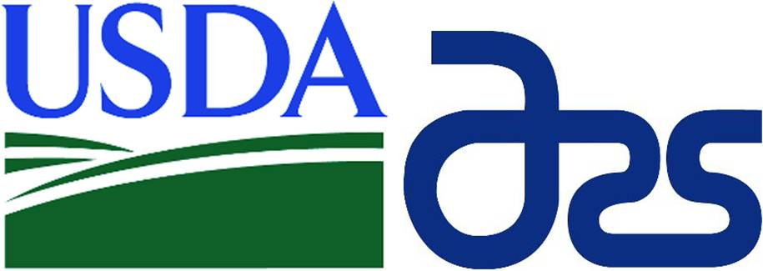


Acknowledgments

Slide 17


Additional Information
Agronomic Crops Network
Ohio State University Extension
https://agcrops.osu.edu/newsletter/corn-newsletter
http://cropprotectionnetwork.org

