Slide 1

Management of FHB and DON in Wheat:
A 2022 Update
Drs. Pierce A. Paul and Wanderson Bucker Moraes
The Ohio State University

Slide 2
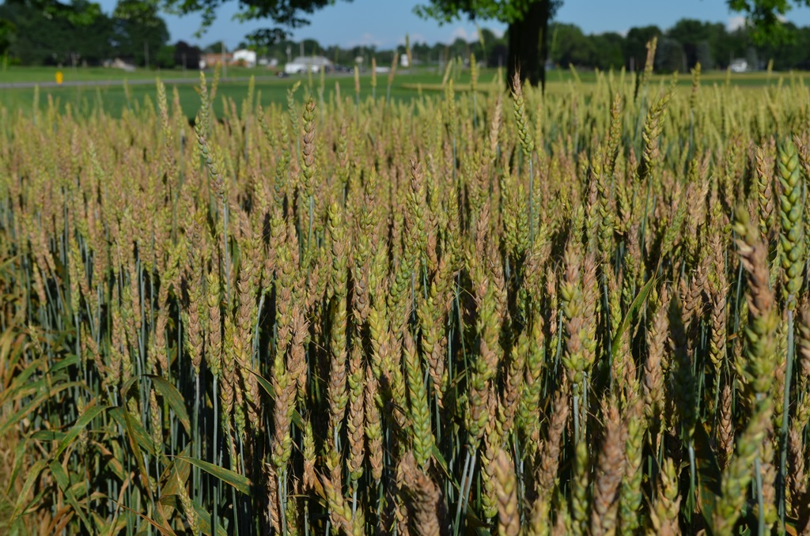
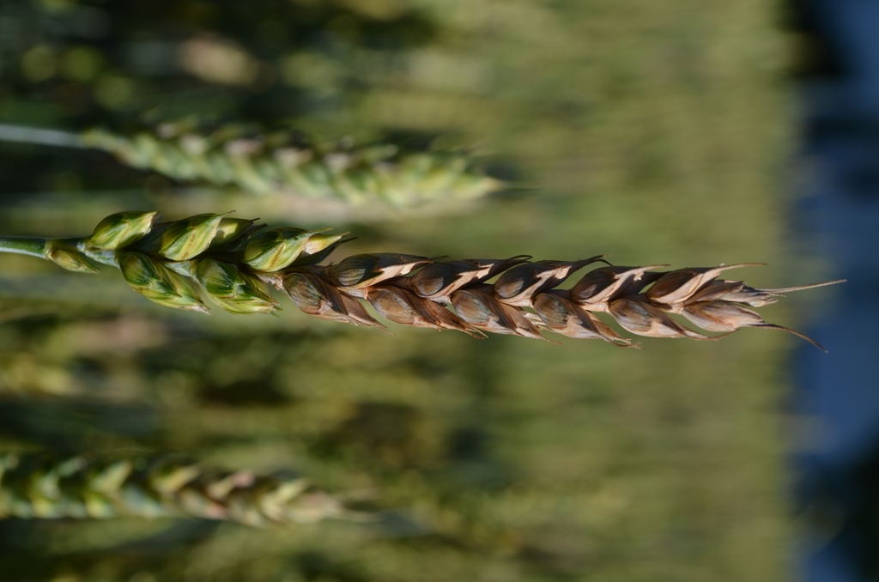
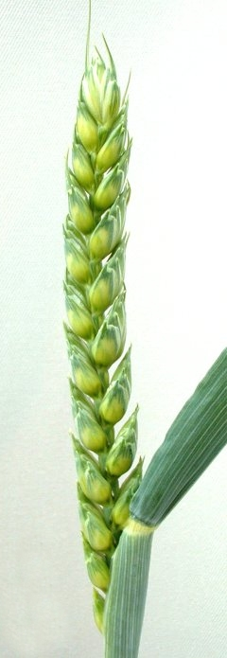
Fusarium head blight (head scab)
Fusarium graminearum (Gibberella zeae)
Grain yield and quality losses
Grain contamination with mycotoxins
Food safety concerns – humans and animals
Reduce flour yield and milling and baking quality

Slide 3
Miravis Ave
SDHI - Pydiflumetofen
+
DMI - Propiconazole

Slide 4
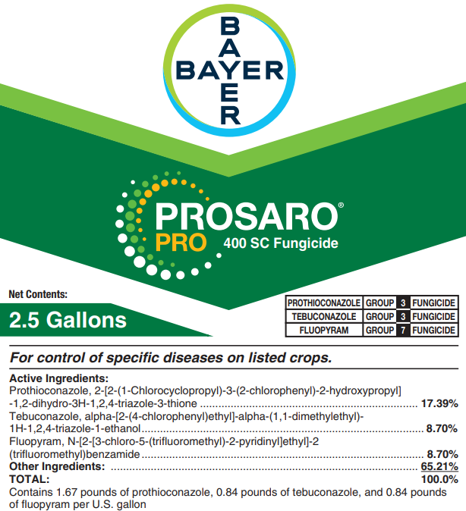
Prosaro Pro
DMI – Prothioconazole
+
DMI – Tebuconazole
+
SDHI – Fluopyram

Slide 5
Sphaerex
DMI – Metconazole
+
DMI – Prothioconazole

Slide 6
Fungicide-Only Programs:
New Products vs Industry Standards

Slide 7
Field experiments were conducted in 16 US wheat-growing states in 2022
Mean IND data was obtained from 21 environments and DON grain contamination data from 20 environments
Means IND ranged from 0 to 50% across the 21 environments and among management programs
Mean DON contamination of grain ranged from 0 to 52 ppm across the 20 environments and among management programs

Slide 8
Fungicide Programs
Treatment program | Treatment Program | Rate (fl oz/A) | Timing
Code | Product
CK | Nontreated | --- | ---
I | Prosaro | 6.5 | Feekes 10.5.1
II | Caramba | 13.5 | Feekes 10.5.1
III | Miravis Ace | 13.7 | Feekes 10.5.1
IV | Prosaro Pro | 10.3 | Feekes 10.5.1
V | Sphaerex | 7.3 | Feekes 10.5.1
VI | Miravis Ace fb Prosaro Pro | 13.7/10.3 | Feekes 10.5.1/4-6 DAA
VII | Miravis Ace fb Sphaerex | 13.7/7.3 | Feekes 10.5.1/4-6 DAA
VIII | Miravis Ace fb Tebuconazole | 13.7/4 | Feekes 10.5.1/4-6 DAA
DAA = days after anthesis (Feekes 10.5.1)
All treatments applied with a non-ionic surfactant @ 0.125% V/V

Slide 9
Head Scab (FHB)
55 to 86%
Reduction in Scab
Fungicide treatment programs: non-treated check (CK), or an application of Prosaro (I), Caramba (II), Miravis Ace (III), Prosaro Pro (IV), or Sphaerex (V) at anthesis, or Miravis Ace at anthesis followed by an application of Prosaro Pro (VI), Sphaerex (VII), or Tebuconazole (VIII) at 4-6 days after anthesis.
Notes:
Two-treatment programs resulted in the lowest levels of Scab

Slide 10
Vomitoxin (DON)
36 to 75%
Reduction in DON
Fungicide treatment programs: non-treated check (CK), or an application of Prosaro (I), Caramba (II), Miravis Ace (III), Prosaro Pro (IV), or Sphaerex (V) at anthesis, or Miravis Ace at anthesis followed by an application of Prosaro Pro (VI), Sphaerex (VII), or Tebuconazole (VIII) at 4-6 days after anthesis.
Notes:
Two-treatment programs resulted in the lowest levels of DON

Slide 11
Efficacy Compared to Prosaro - FHB
Fungicide programs: Caramba (II), Miravis Ace (III), Prosaro Pro (IV), or Sphaerex (V) at anthesis, or Miravis Ace at anthesis followed by an application of Prosaro Pro (VI), Sphaerex (VII), or Tebuconazole (VIII) at 4-6 days after anthesis.
Notes:
Performance of New products and two-treatments programs compared to Prosaro at anthesis:
Bars above the 0-reference line show programs that are x% better than Prosaro at reducing head scab (FHB)

Slide 12
Efficacy Compared to Prosaro - DON
Fungicide programs: Caramba (II), Miravis Ace (III), Prosaro Pro (IV), or Sphaerex (V) at anthesis, or Miravis Ace at anthesis followed by an application of Prosaro Pro (VI), Sphaerex (VII), or Tebuconazole (VIII) at 4-6 days after anthesis.
Notes:
Performance of New products and two-treatments programs compared to Prosaro at anthesis:
Bars above the 0-reference line show programs that are x% better than Prosaro at reducing vomitoxin (DON)

Slide 13
Integrated Management:
Fungicide + Variety Resistance

Slide 14
Field experiments were conducted in 18 US wheat-growing states in 2022
Mean IND data was obtained from 22 environments and DON grain contamination data from 20 environments
Means IND ranged from 0 to 71% across the 22 environments and among management combinations
Mean DON contamination of grain ranged from 0 to 35 ppm across the 20 environments and among management combinations

Slide 15
Integrated Management Programs
Fungicide Treatments
Treatment program | Treatment Program | Rate (fl oz/A) | Timing
Code | Product
CK | Nontreated | --- | ---
I | Prosaro | 6.5 | Feekes 10.5.1
II | Miravis Ace | 13.7 | Feekes 10.5.1
III | Prosaro Pro | 10.3 | Feekes 10.5.1
IV | Sphaerex | 7.3 | Feekes 10.5.1
All treatments applied with a non-ionic surfactant @ 0.125% V/V
Cultivar Resistance
MR, MS, and S

Slide 16
Fungicide x Resistance - Scab
91 to 95% Reduction
87 to 89% Reduction
55 to 81% Reduction
MR = Moderately Resistant, MS = Moderately Susceptible, S = Susceptible
CK: non-treated; I – Prosaro, II - Miravis Ace, III - Prosaro Pro, IV - Sphaerex
Notes:
Integrated management programs: - percent reduction estimated relative to S_CK (the susceptible untreated check)
All fungicides performed equally well at reducing scab on MR and MS varieties
Lowest levels of disease when fungicide treatments were combined with moderate resistance

Slide 17
Fungicide x Resistance - DON
82 to 86% Reduction
62 to 67% Reduction
56 to 66% Reduction
MR = Moderately Resistant, MS = Moderately Susceptible, S = Susceptible
CK: non-treated; I – Prosaro, II - Miravis Ace, III - Prosaro Pro, IV - Sphaerex
Notes:
Integrated management programs: percent reduction estimated relative to S_CK (the susceptible untreated check)
All fungicides performed similarly at reducing DON within a given variety resistance class
Lowest levels of disease when fungicide treatments were combined with moderate resistance

Slide 18
Take-home message on Head Scab
In the UFTs, Prosaro Pro and Sphaerex were of comparable efficacy to Prosaro against IND, but both products, as well as Miravis Ace, were slightly more effective than Prosaro against DON
Treatments consisting of an anthesis application of Miravis Ace followed by a “later” application of Prosaro Pro, Sphaerex, or Tebuconazole were more effective against IND and DON than an anthesis-only application of any of the tested fungicides.
The new fungicide mixtures were quite effective against FHB and DON, with the highest percent control when used in combination with genetic resistance.
When applied with Induce, all tested fungicides were rainfast immediately after application under a range of simulated rainfall scenarios.

Slide 19
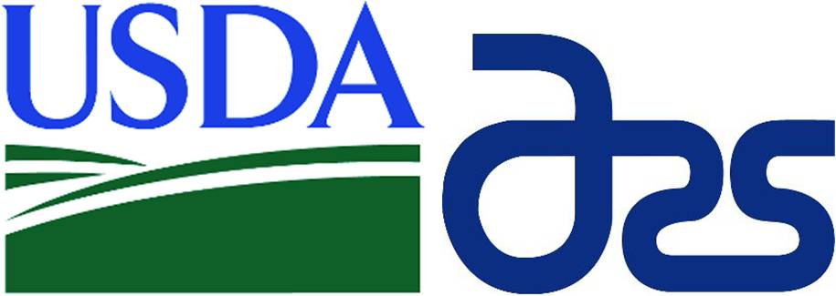


Acknowledgments

Slide 20


Additional Information
Agronomic Crops Network
Ohio State University Extension
https://agcrops.osu.edu/newsletter/corn-newsletter
http://cropprotectionnetwork.org

